Slide 1
IU School of Education Faculty Meeting
April 21, 2017

Slide 2
RANKINGS

Slide 3
FACULTY

Slide 4
TOTAL STUDENT POPULATION BY GENDER
SOURCE: Estimate based on IU Decision Support Initiative (DSI) Report. Includes EDUC1 and UDED1

Slide 5
UNDERGRAD and GRAD STUDENTS BY GENDER
SOURCE: Estimate based on IU Decision Support Initiative (DSI) Report. Includes EDUC1 and UDED1

Slide 6
UNDERGRAD and GRAD STUDENTS BY ETHNICITY
SOURCE: Estimate based on IU Decision Support Initiative (DSI) Report. Includes EDUC1 and UDED1

Slide 7
RESEARCH & DEVELOPMENT (NEW FUNDS)

Slide 8
RESEARCH & DEVELOPMENT (NEW FUNDS)
8

Slide 9
IUPUI
Undergraduate Enrollment

Slide 10
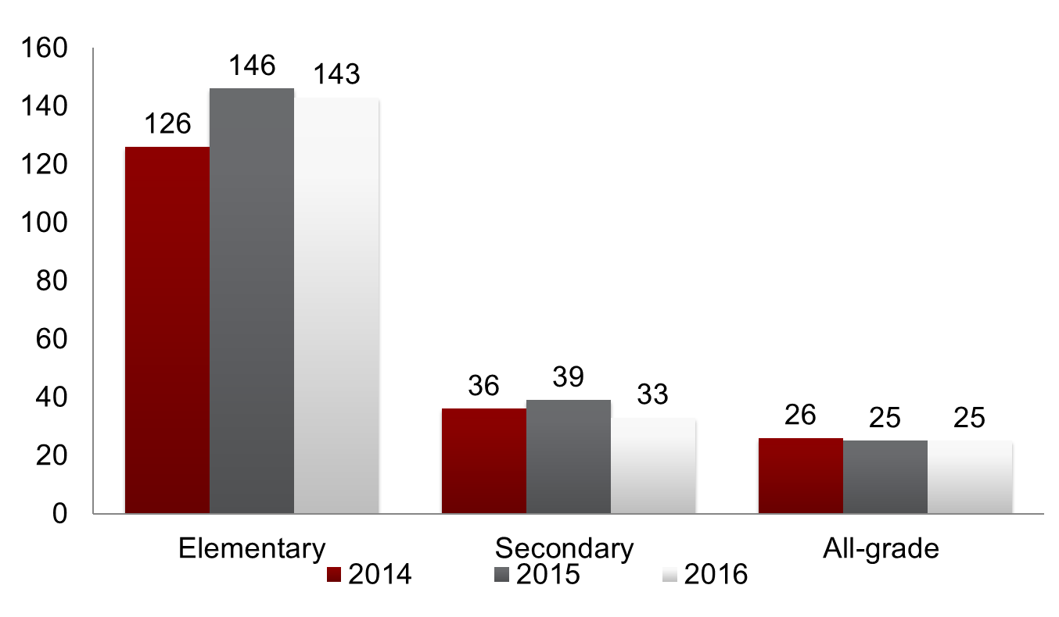
IUPUI Admissions

Slide 11
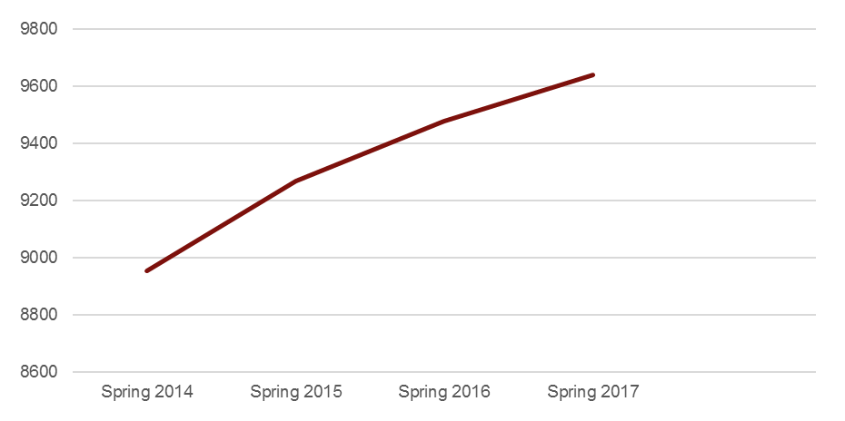
IUPUI Undergraduate Credit Hours
tends based on spring credit hours
Approximate 8% increase in spring credit hours from 2014 to 2017

Slide 12
IUPUI
Graduate Enrollment

Slide 13
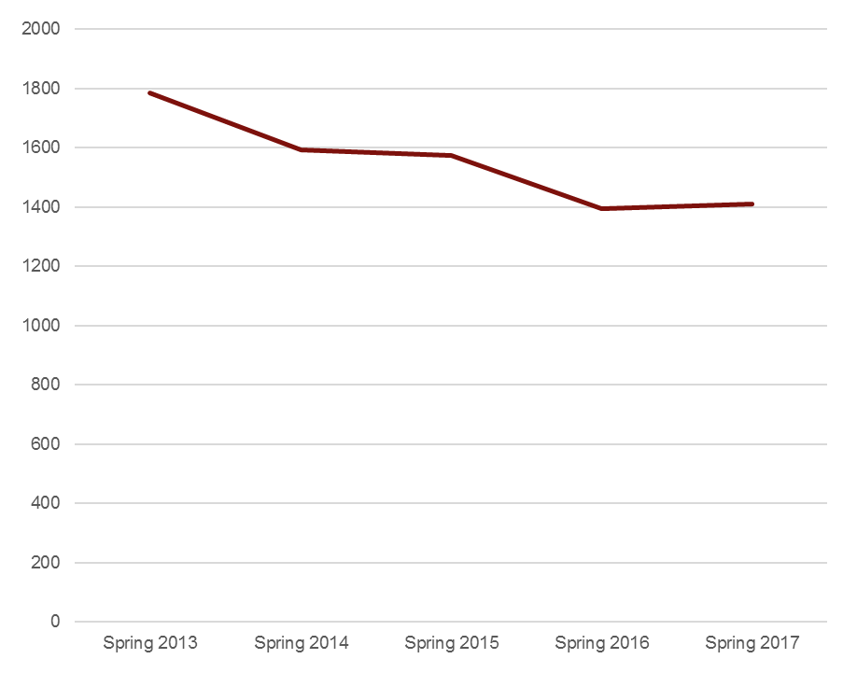
IUPUI Graduate Credit Hours
tends based on spring credit hours
doctoral research hours have increased from 9% of total graduate credit hours in spring 2013 to 19% in spring 2017

Slide 14
IUPUI
Graduate Enrollment by Ethnicity

Slide 15
IUPUI Graduate Enrollment by Ethnicity
 | Academic Year 2012-2013 | Academic Year 2013-2014 | Academic Year 2014-2015 | Academic Year 2015-2016
American Indian/ Alaska Native | 1 | 0 | 0 | 0
Asian | 11 | 8 | 7 | 8
Black/African American | 43 | 65 | 71 | 73
Hispanic/Latino | 12 | 18 | 15 | 10
Native Hawaiian/ Pacific Islander | 0 | 0 | 0 | 0
Non-US Citizen | 3 | 4 | 3 | 4
Two or More Races | 9 | 5 | 7 | 7
Unspecified | 3 | 2 | 2 | 4
White | 394 | 336 | 336 | 339

Slide 16
IUPUI
Undergraduate Enrollment by Ethnicity

Slide 17
IUPUI Undergraduate Enrollment by Ethnicity
 | Academic Year 2012-2013 | Academic Year 2013-2014 | Academic Year 2014-2015 | Academic Year 2015-2016
American Indian/ Alaska Native | 0 | 1 | 2 | 2
Asian | 10 | 11 | 11 | 12
Black/African American | 55 | 45 | 44 | 48
Hispanic/Latino | 32 | 33 | 24 | 42
Native Hawaiian/ Pacific Islander | 0 | 0 | 0 | 0
Non-US Citizen | 0 | 1 | 3 | 7
Two or More Races | 19 | 21 | 19 | 18
Unspecified | 6 | 5 | 3 | 5
White | 637 | 541 | 552 | 545

Slide 18
School of Education - IUPUI
Bicentennial Campaign Update
January 1, 2012 – December 31, 2016
  School Total: $447,514 GIFTS
        $539,090 GRANTS
        $986,604 TOTAL 70.47% to goal of $1.4 million
  60 months or 63% into a 96 month campaign
  $413,396 to be raised (29.53% of goal)

Slide 19
Sponsored Research Trends FY13 to FY17
School of Education IUPUI
 | FY 2013 | FY 2014 | FY 2015 | FY 2016 | FY 2017 July 1, 2016 – March 31, 2017
Proposal Numbers | 24 | 15 | 23 | 21 | 22
Proposal Dollars | $3,404,199 | $2,797,775 | $5,225,397 | $6,396,771 | $17,203,594
Award Numbers | 14 | 14 | 21 | 16 | 19
Award Dollars | $2,034,375 | $1,814,356 | $2,239,782 | $1,878,068 | $2,277,298
Expenditure Dollars | $2,405,701 | $2,405,733 | $1,915,751 | $2,075,350 | $1,142,219
Indirect Dollars | $268,602 | $321,459 | $280,228 | $330,584 | $211,876
IC as % of Exp | 11.2% | 13.4% | 14.6% | 15.9% | 18.5%

Slide 20
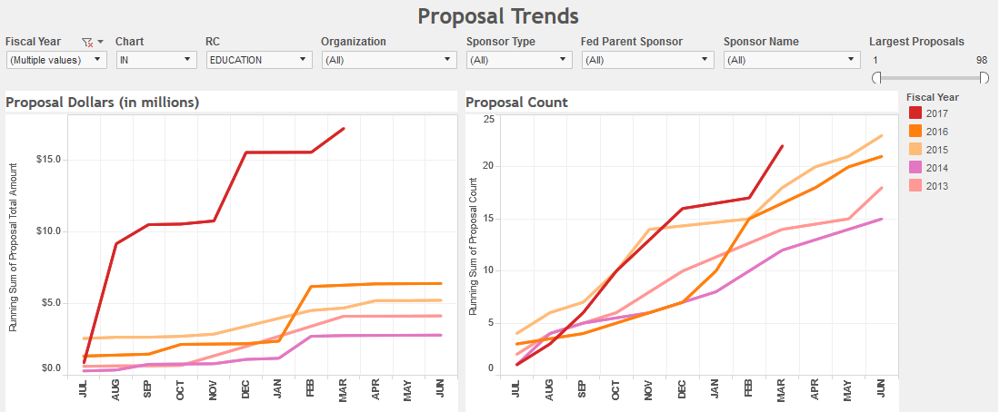
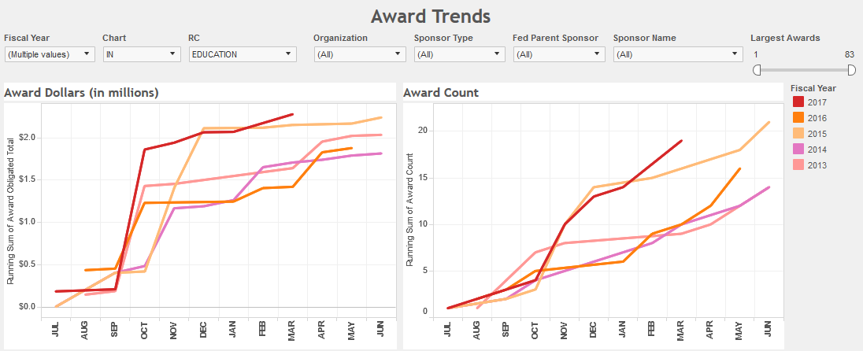
School of Education IUPUI

Slide 21
Thank you –

Slide 22
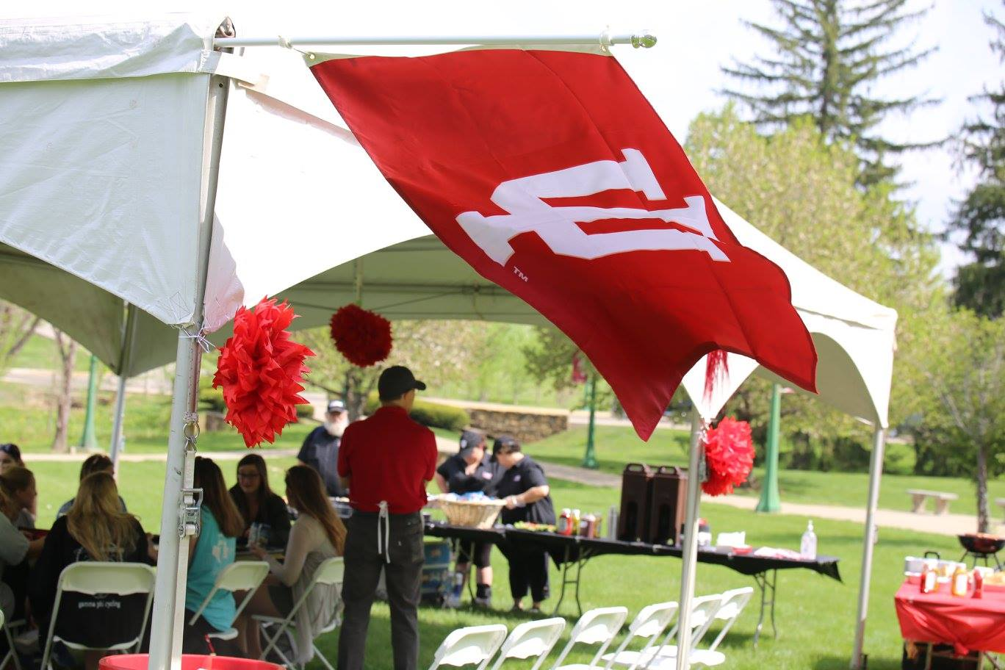
Bloomington Campus Faculty Meeting
Friday, April 21, 2017

Slide 23
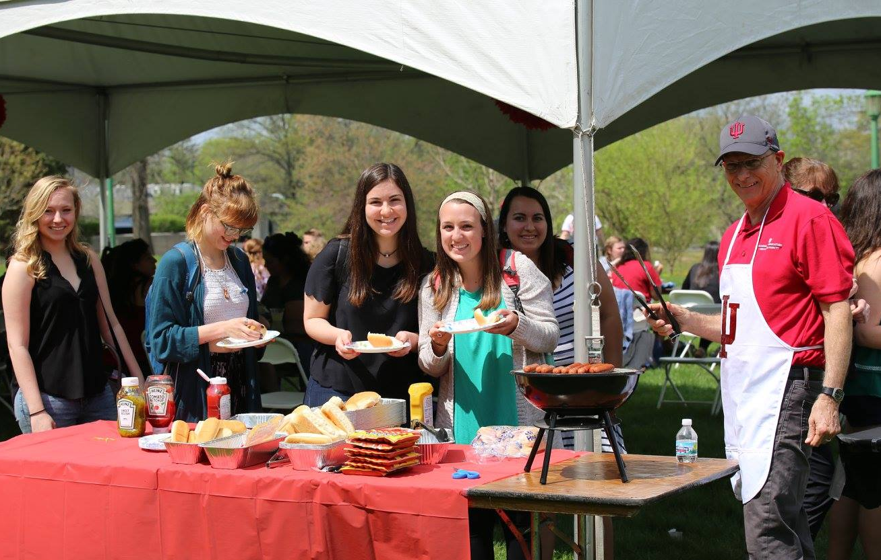
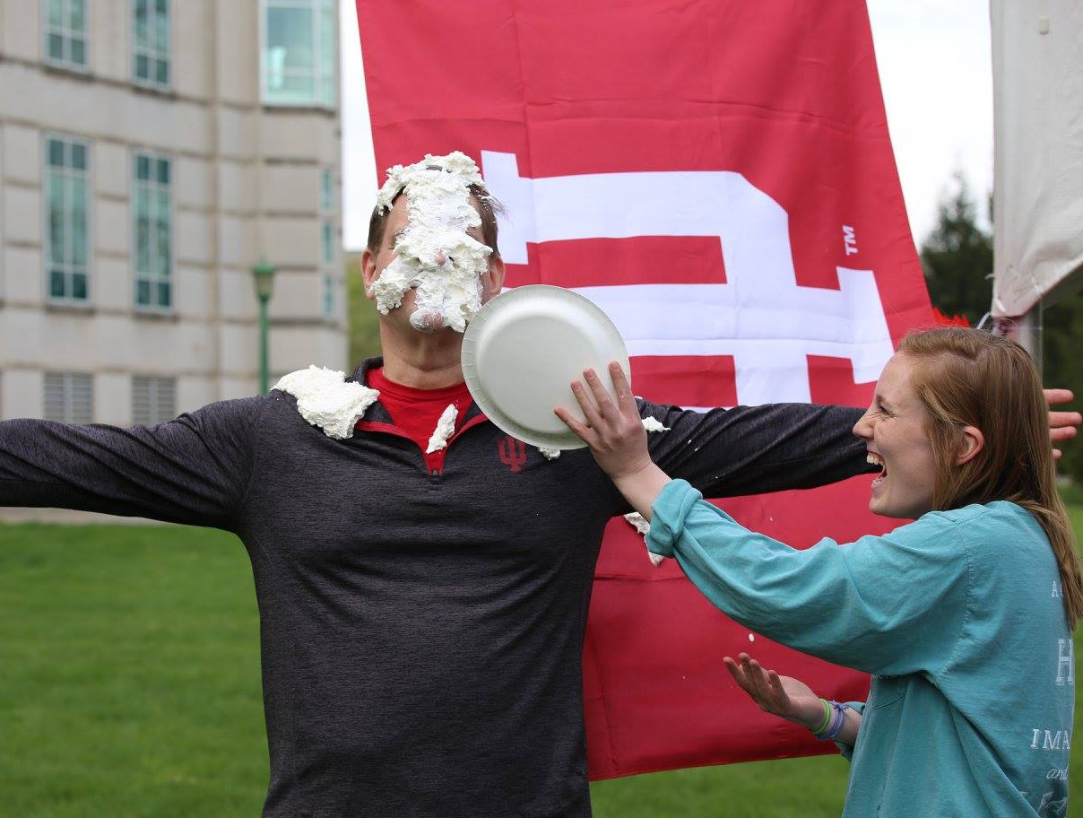
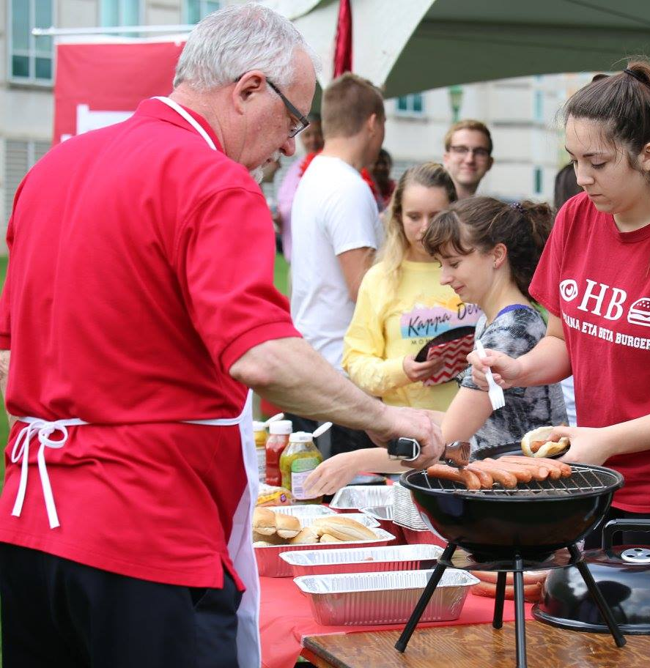
IU Day

Slide 24
Social Media Stats IU Day
Best performing posts:
2,100 reach:
Keith Barton Pie-in-the-face video
1,406 reach for Jongsma Global Gateway announcement
1,500 engagement on IU Day photo album
Facebook
3,664 – Post Engagements 2,903% increase

Slide 25
Teacher Education Admissions

Slide 26
Teacher Education Admissions
 | 2017 | 2016 | % Change
Direct Admits | 545 | 433 | +26%
Total Admits | 866 | 751 | +15%
Direct Admit Deposit | 147 | 113 | +30%
Total Deposit | 248 | 212 | +17%

Slide 27
Teacher Education Admissions

Slide 28
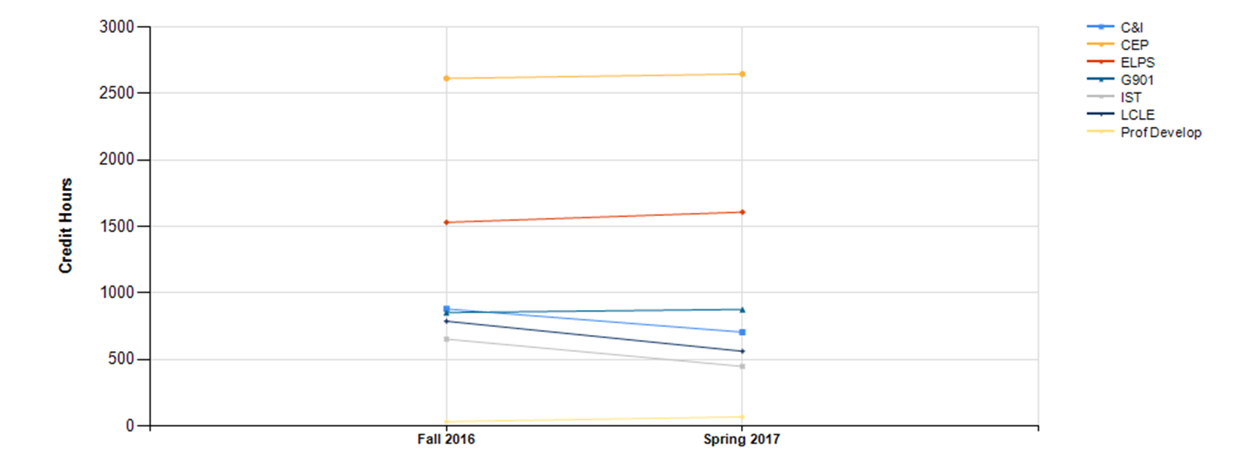
Total Credit Hours by Department
Term Comparison

Slide 29
Fall 2016 – Spring 2017
Dept. | Fall 2016 | Spring 2017
C&I | 879 | 705
CEP | 2,614 | 2,647
ELPS | 1,531 | 1,608
G901 | 852 | 876
IST | 652 | 447
LCLE | 787 | 561
Prof Develop | 31 | 67
Total | 7,346 | 6,911

Slide 30
Budget Summary
Bloomington

Slide 31
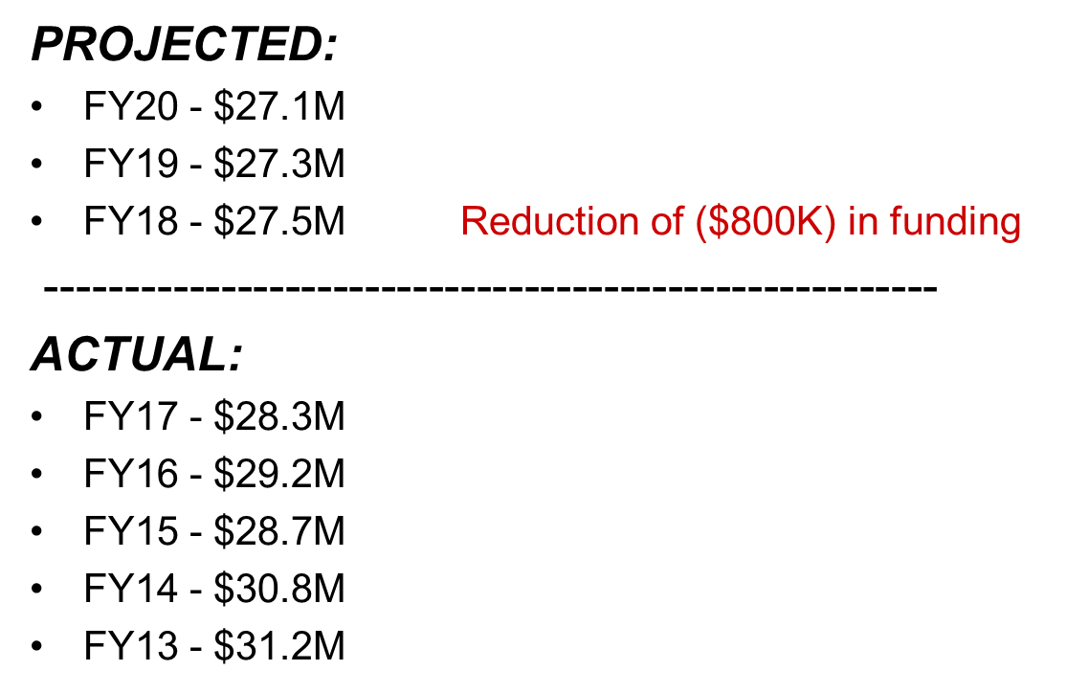
BL - Base Budget Over Time

Slide 32
What Generates Surplus?
How Does the School Apply Surplus?
Sources of Surplus Salary transfer to grants (course buyouts) Extended vacancies Spending below budget ICR above budget Credit hours above budget | Applications Faculty research accounts Faculty sponsored projects Undergraduate direct admit scholarships & graduate fellowships Technology & classroom improvements

Slide 33
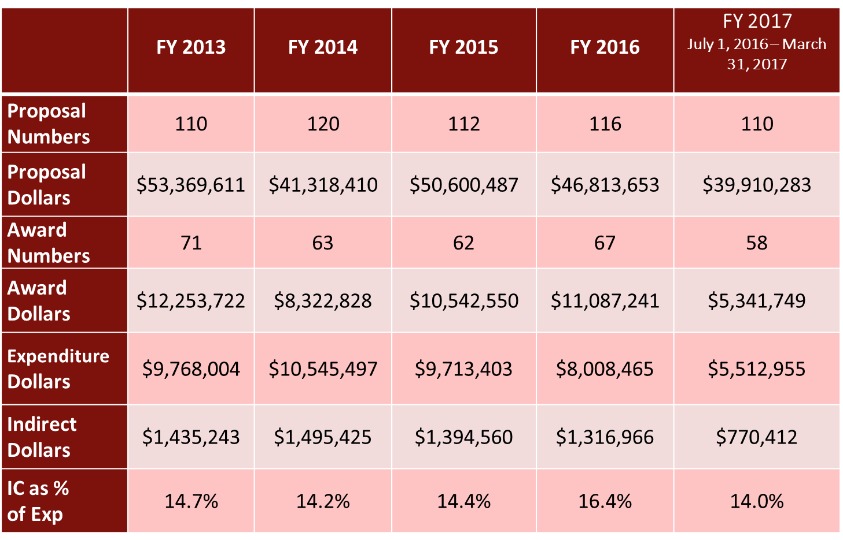
Sponsored Research Trends
FY13-FY17 Bloomington

Slide 34
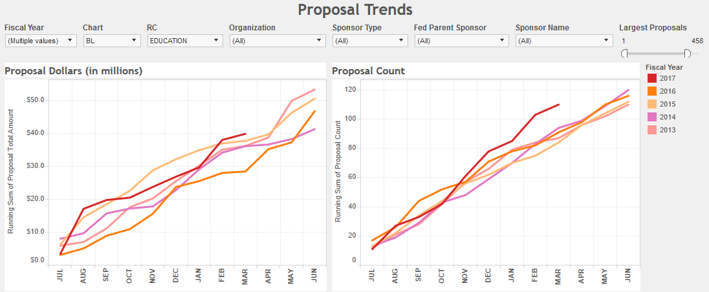
Bloomington Proposal Trends

Slide 35
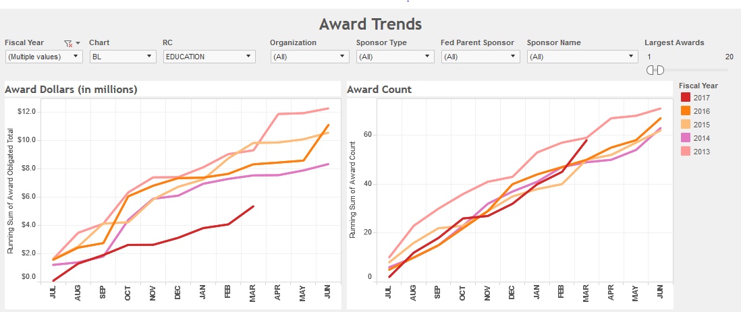
Bloomington Award Trends

Slide 36
Bicentennial Campaign Report
$40 Million Goal: $20 million in nongovernment grants, $20 million in gifts
64% to goal at $25,605,040 as of April, 2017
$13 million for nongovernment grants and more than $12.5 million in philanthropic support
Faculty Generosity
93 School of Education faculty have made gifts totaling $198,361
121 School of Education retirees have made gifts totaling more than $3.2 million
Interesting fact: If faculty and staff make a $25,000 endowment pledge through cash or estate plans, their gift will be matched by the University.
$40 Million Goal

